Slide 1



SENTIMENT ANALYSIS USING RANDOM FOREST
Pinak Dusane- 58
Shashank Prabhat- 67
Siddharth Somani- 73
Shubhangi Chatterjee- 71
Bhaumik Pandya- 44
Shriya Verma- 69

Slide 2
GitHub Links
Name | GitHub Account Link
Shashank Prabhat | https://github.com/Shashank-Analytics
Pinak Dusane | https://github.com/icantcodeman2
Siddharth Somani | https://github.com/sidsom-13
Shubhangi Chatterjee | https://github.com/shubhangichatterjee27
Bhaumik Pandya | https://github.com/bhaumik-pandya
Shriya Verma | https://github.com/shriyaverma01
https://colab.research.google.com/drive/10NkH4AIBkH52wZsy0HvUxJaI1e-xzz-l?usp=sharing#scrollTo=8_f8jCwm1a8d

Slide 3
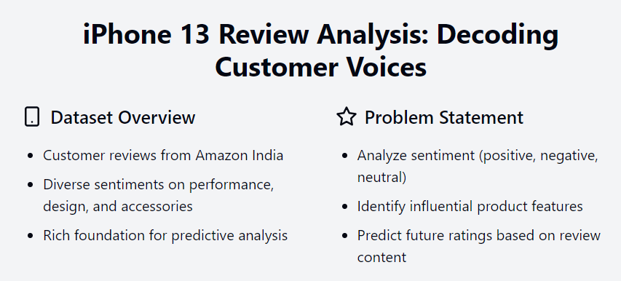
Introduction
Project Objectives
Conduct Text Analytics: Utilize Random Forest for sentiment classification.
Key Steps:
Data Preprocessing: Clean, tokenize, and normalize text.
Feature Extraction: Convert text into numerical format (e.g., TF-IDF, embeddings).
Model Training: Implement Random Forest to build a robust classifier.
Model Evaluation/Comparison: Assess accuracy and interpret feature importance.
Type: Textual data (e.g., product reviews, social media comments)
Size: Extensive collection (varies by source)
Source: Platforms like Amazon, Yelp, Twitter, etc.

Slide 4
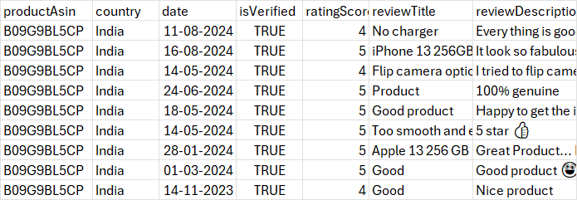
Introduction

Slide 5

Data Cleaning and Processing
Data Collection
Normalization
Tokenization
Stop Words Removal
Lemmatization/Stemming
Feature Extraction
Data Splitting
Model Training and Evaluation

Slide 6

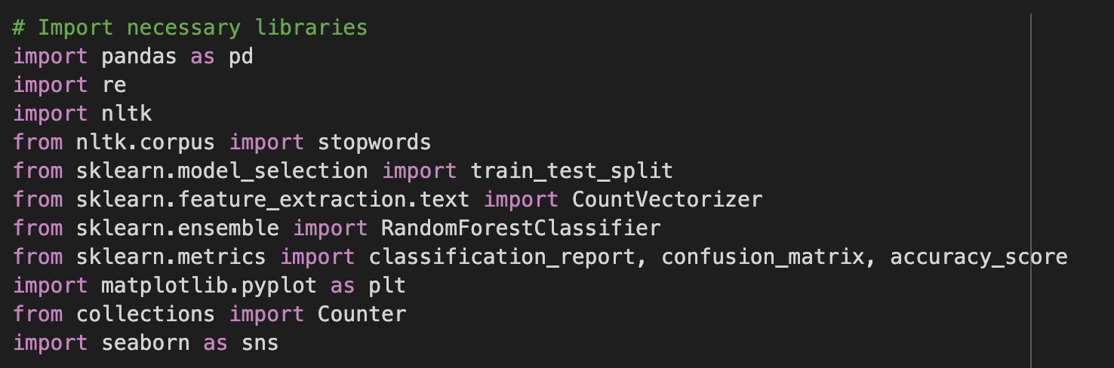
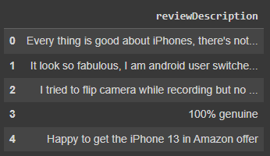
Data Importingp

Slide 7

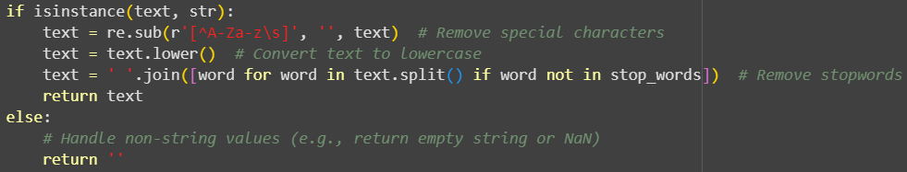
Data Cleaning & Normalization
Data with NaN values were removed
All text was converted to lowercase
Special characters, emojis, and stopwords were removed
Lemmatization was performed
Performed Tokenization using word_tokenize

Slide 8
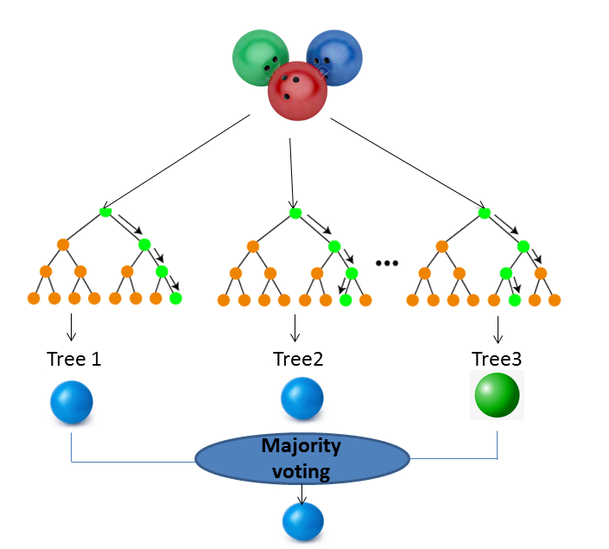
Understanding Random Forest
Random Forest is a machine learning algorithm made up of multiple decision trees. Each decision tree is trained on random subsets of data. In the case of sentiment analysis, each tree makes predictions (positive/negative/neutral sentiment), and then the forest (a collection of trees) combines all the predictions and chooses the most frequent one.

Slide 9
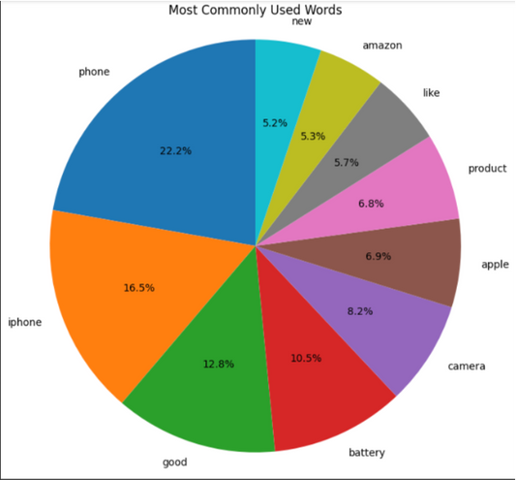
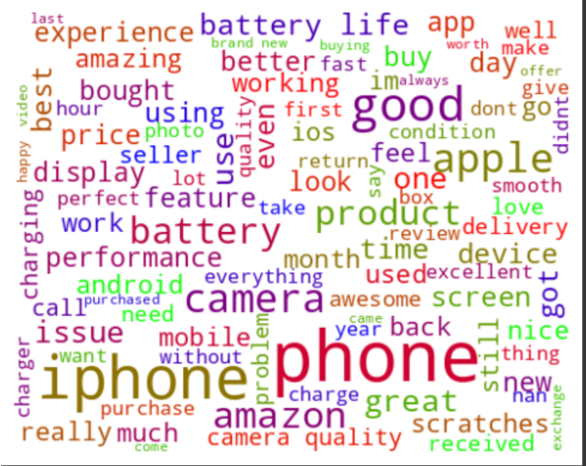
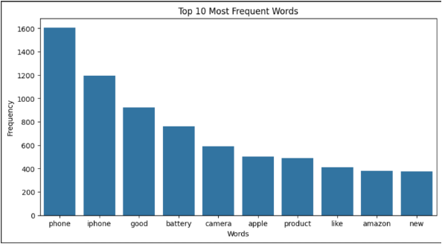
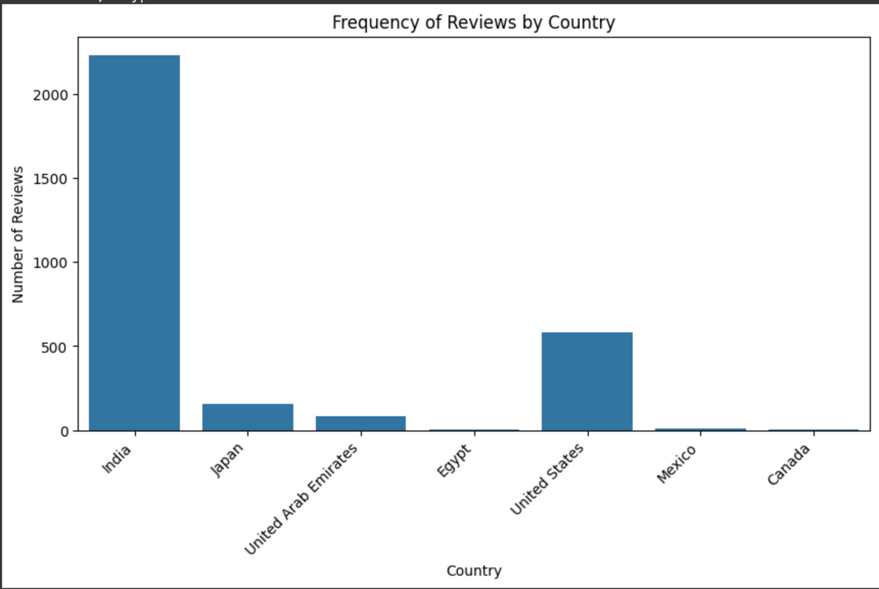
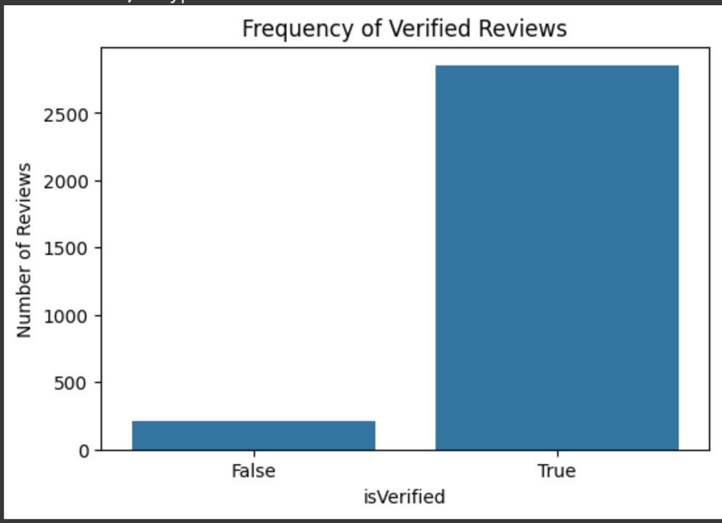

Slide 10
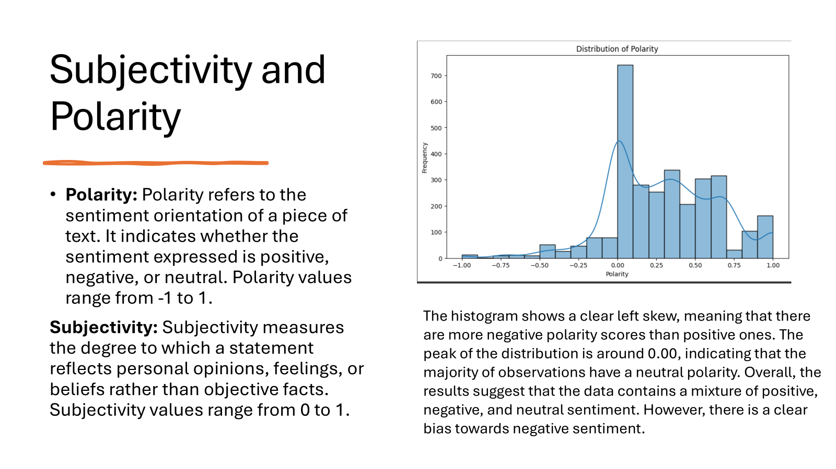

Slide 11
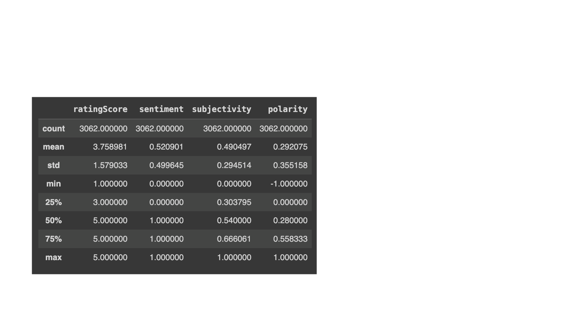
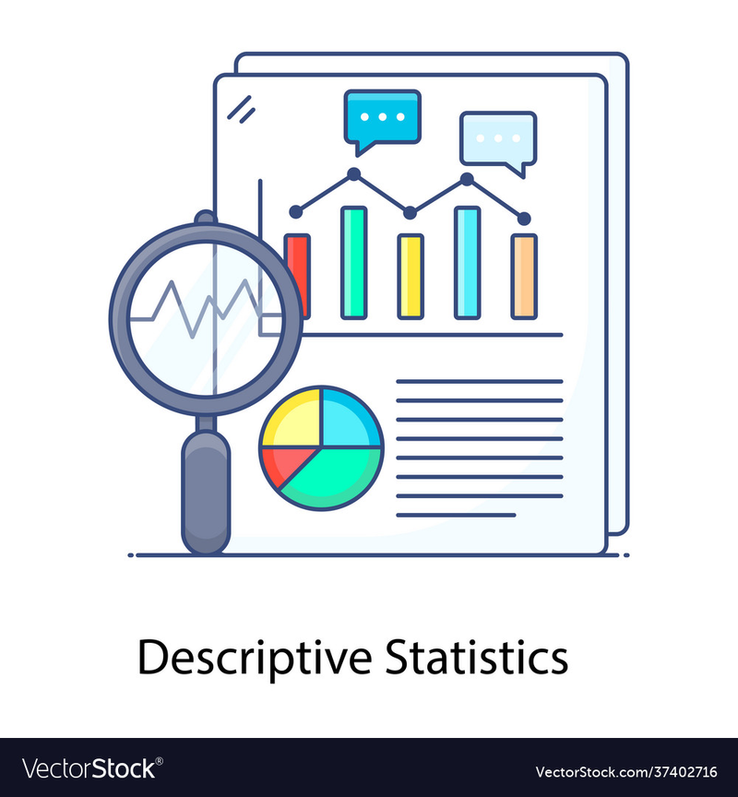
Summary Statistics
It is a dataset of 3062 data points related to ratings, sentiment, subjectivity, and polarity.
The mean sentiment is 0.520901, which is closer to positive than negative sentiment.
The average subjectivity is 0.490497, indicating a moderate level of subjective content in the data.
The data suggests a dataset of product ratings with a generally positive sentiment, but with some variation in subjectivity and polarity.

Slide 12
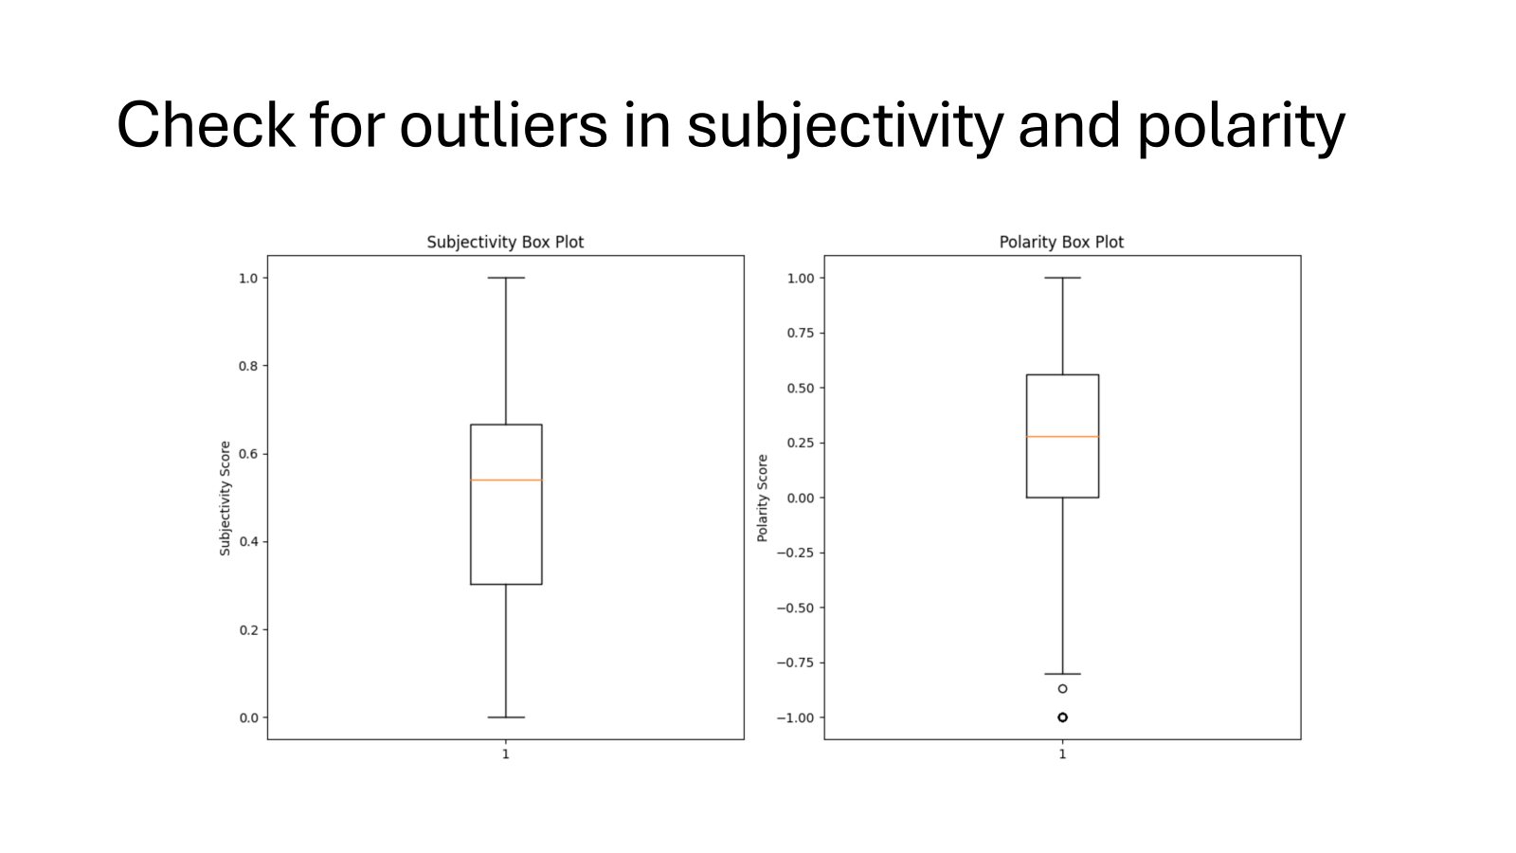
Check for Outliers in Subjectivity & Polarity
The box plots show the distribution of subjectivity and polarity scores. Outliers, identified as points outside the whiskers, can significantly affect analysis. It's important to investigate and address outliers to ensure accurate and reliable conclusions.

Slide 13
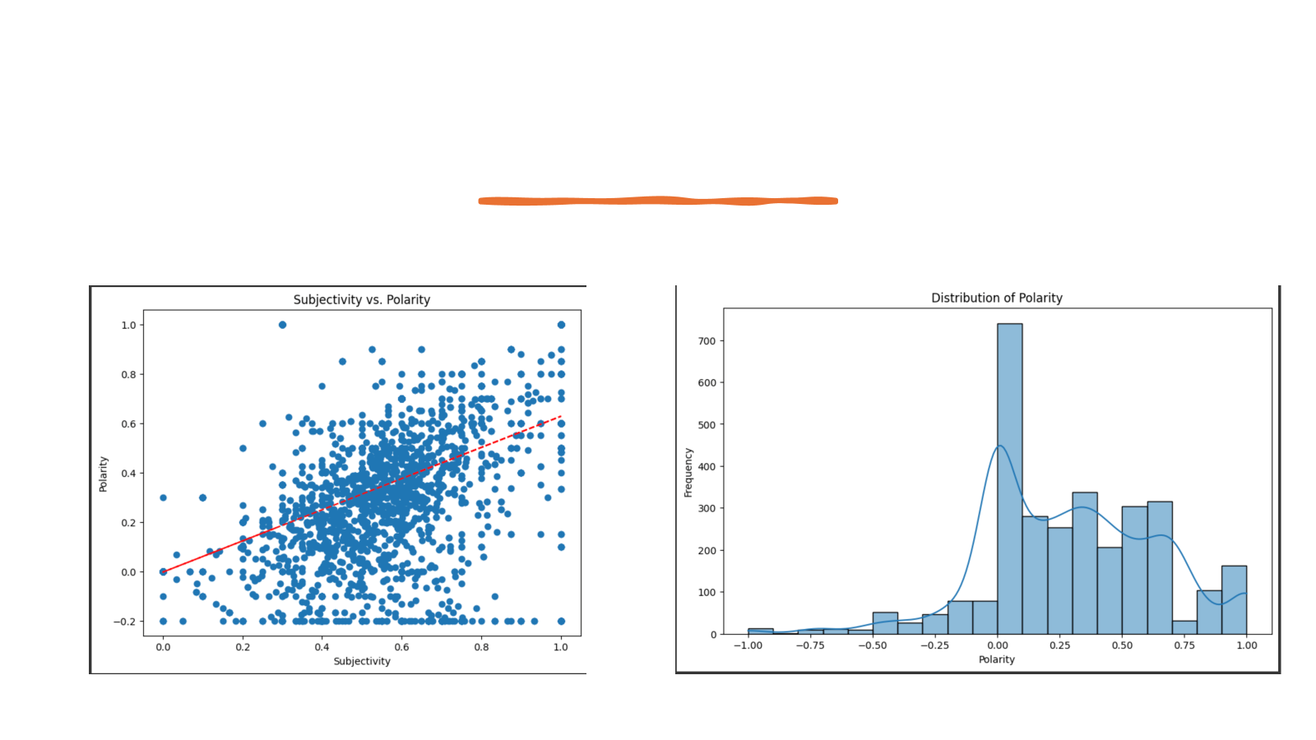
Scatter Plot of Subjectivity vs. Polarity
Histogram of Polarity
Trend line: The red line indicates a positive correlation between subjectivity and polarity. This suggests that as the subjectivity of a review increases, its polarity (positive or negative sentiment) tends to also increase.
Shape: The distribution is skewed to the right, meaning there are more positive reviews than negative reviews. The peak of the distribution is around the 0.25-0.5 range, indicating that a majority of reviews have a slightly positive sentiment.

Slide 14
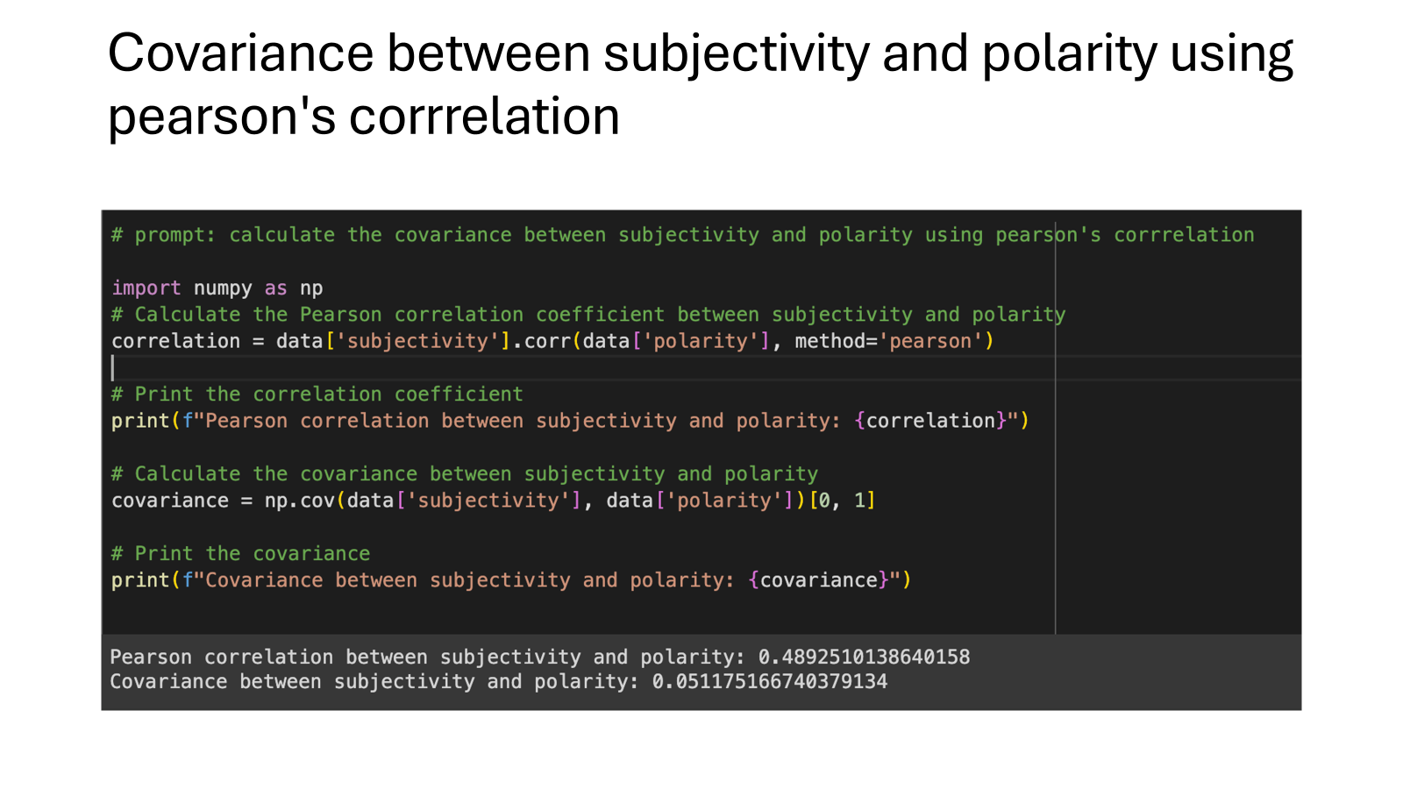
Covariance b/w Subjectivity and Polarity using Pearson’s Correlation
The code calculates the Pearson correlation coefficient and covariance between subjectivity and polarity. The results show a positive correlation of 0.489 and a covariance of 0.051, indicating a moderate positive relationship between the two variables.

Slide 15
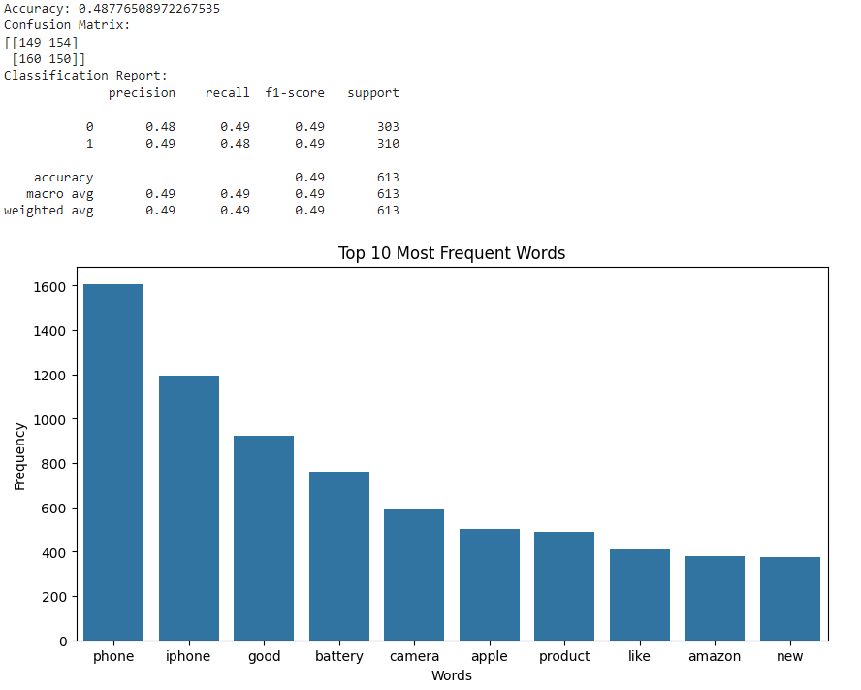
Random Forest
The random forest model achieved an accuracy of 0.49, indicating moderate performance in classifying sentiment. The confusion matrix shows that the model correctly predicted 149 out of 303 positive instances and 154 out of 310 negative instances. The classification report further highlights balanced precision, recall, and F1-score across both classes, suggesting that the model is neither significantly biased towards one class nor heavily penalized by false positives or negatives. The top 10 most frequent words in the dataset include "phone," "iphone," "good," "battery," "camera," "apple," "product," "like," "amazon," and "new." These words likely play a significant role in determining the sentiment of the text.

Slide 16
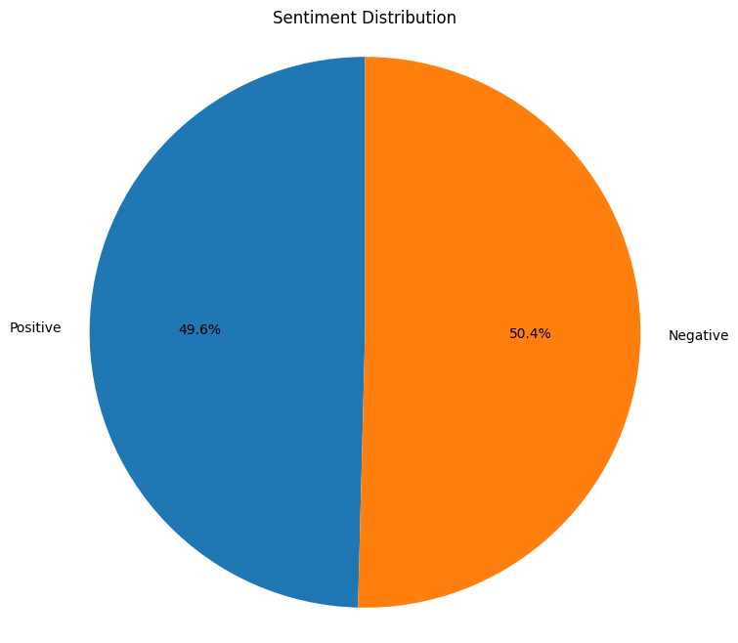
Random Forest
Sentiment
Distribution

Slide 17
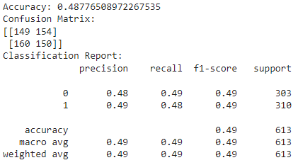
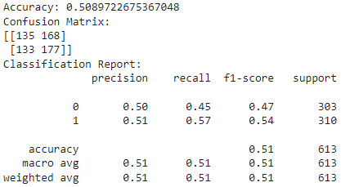
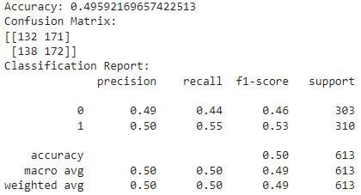
Comparing with other models
Random Forest
SVM
Logistic Regression

